Slide 1
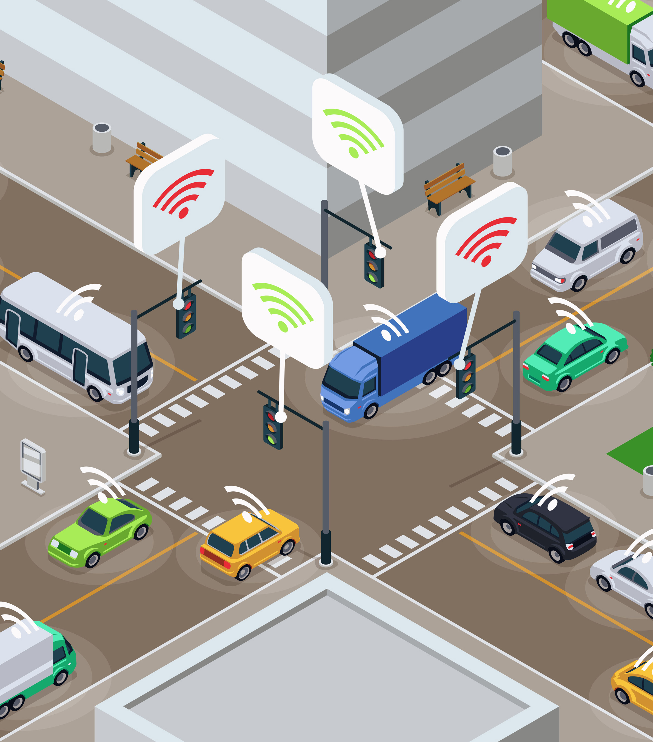

Solving an account challenge with NextGen Manage capabilities
Case Study Connected-cars to Market – The quicker way of applying
NextGen HCMS skills for value realization
submission by – Ravindra A. Nikam,
PMP, ITIL, SSGB, AZ-900, Devops, AI, ML certified

Slide 2
Connected-cars to Market – The quicker way of applying NextGen HCMS skills for value realization (As-Is)
Client account size @250
Medium sized account with 250 professionals for global automobile manufacturer.
Multi-vendor
The client has a very large IT estate supported by multiple Vendors, and IBM is managing a small portion of the portfolio which includes few mission critical applications including the external facing Web application for their connected-cars solution.
Unclear Automation
capability
While most applications are hosted in private cloud, some critical applications are running on AWS
Agile + Devops* Manual Testing
Despite of the good quality services provided by IBM with high NPS scores, client is expecting IBM to reduce the cost of operation by 20% and faster the time-to-market and quality of the applications
Vendor support quality issue
Client also communicated that the connected-cars applications supported by IBM are expected to handle increased load in the coming quarters and asked IBM to provide an uptime commitment of at least 99.90%
Cost of operation
Build and deploy of the applications follow Agile method with many DevOps tools in place. However, some steps in the processes are still manual along with completely manual testing.
Increased load
Over the years significant number of automation scripts were developed, many of which were one off use-cases. There is no visibility into what automation capabilities are available across the board.
Private + Public
cloud
Many other critical applications in the portfolio are managed by two other vendors, and based on our experience, client has significant challenges related to the service quality and innovation in those areas.
Applications on Legacy & outdated platforms
Many of these applications are running on legacy and outdated platforms with many compliance issues
Propose NextGen solution
As a PM/ DM in the account, what would be your proposal and action plan to address the requirements from the client?
Accelerate
Innovate
Elevate

Slide 3
ROADMAP
Hybrid Cloud (6-12 months)
Dynamic Delivery Via Talent Transformation & Cognitive Enterprise powered by AI
(3 months – 1 year)
08
Hybrid cloud solution which shall fit existing AWS etc client cloud setup & future load increase
Add value by converting to smart / cognitive
Entreprise
07
Continuous Modernization
With IBM Garage Method for
Cloud
AMRoadmap (4-12 months)
Intelligent Automation with
IBM Automation Essential Platform
& Operations Command Centre & IBM Automation Platform on Consulting Essentials & Data Modernization & Test Automation (3 months)
06
Design a roadmap for continuous modernization (microservices etc) aligned to larger cloud and business transformation objectives
03
04
05
Build client Automation capability & Proactive issue maintenance through automation
DevSecOps & Site
Reliability Engineering
IBM DevSecOps Commander /
Centre (3 months)
Single Pane Visibility & Service Integration with IBM
IT Control Tower & Process Mining (4 months)
01
Propose to client solution to consolidate DevSecOps assets & build new assets for cost optimization
Celenois, Turbonomics tools shall give observability and help identifying process gaps towards improvements
Garage co-working leverage AIOps insights allowing innovation
02
IBM HCM Incubation / IBM Garage (2 weeks)
Integrate Service Transition & Delivery with IBM Garage & Smarter Transition with SIAM & SNOW & AQL (2-3 months)
Workshop, Ideation, Prioritization, Pipeline Creation with client IT team,
Client Business Users Involving HCM Incubation for Assessment & Solutioning with Account
teams
Through client buyin & Garage approach , propose SIAM for service consolidation for manageability, AIOps
Engage AQL for strategic quality goals

Slide 4
IBM Hybrid Cloud AMS will scale up quickly to drive lasting improvements into client applications, processes, and experience
Optimize workflows through process and IT information with IBM Garage
Assess application portfolio for continuous modernization
Implement IT Control Tower. Infuse AIOps in Service Management
Use process mining and analysis to reduce gaps in business execution and simplify application landscape
Automate using Digital Workers, RPA and Cognitive solutions for proactive/faster issue resolution
DevSecOps / IT Process assessment and implementing toolchain
Talent transformation using new ways of working where business and IT work together to unlock higher value realization
Innovate Processes
Elevate Experience
Application & Service transition
Enterprise-level ISM
Accelerate Applications
Leverage virtual pools of resources/SMEs in a contactless delivery model for better collaboration and faster time to delivery
Drive the transformation journey to become the Cognitive Enterprise
Accelerate efficiency, resilience and agility
Kickstart the IBM Dynamic Delivery Model
Accelerate change deployment while enhancing quality, security and performance
Proactive issue maintenance through automation
Insights and observability to drive operational improvements through the org
Drive visibility and observability into the full IT estate through IBM’s powerful IT Control Tower
Process mining for IT and business process improvement
Business and IT alignment through the Garage model, supported by improved processes and visibility
Prioritize and roadmap strategic technology and talent transformation
Develop a modernization roadmap based on application insights and value stream analysis
Talent transformation and new ways of working through IBM Garage’s co-working methods
Enable BizDevSecOps practices to deliver multi-speed IT, working towards a Cognitive Enterprise
This shows the iterative garage way on how the fit for run (Accelerate), fit for purpose (Innovate) and fit for future (Elevate) vision is achieved and the method,
toolchain and journey that would unfold to make the applications silent/low-touch, ensure they are modernized not only to improve the operational thruput of the
critical workflows but help maximize the yield for strategical transformation.

Slide 5
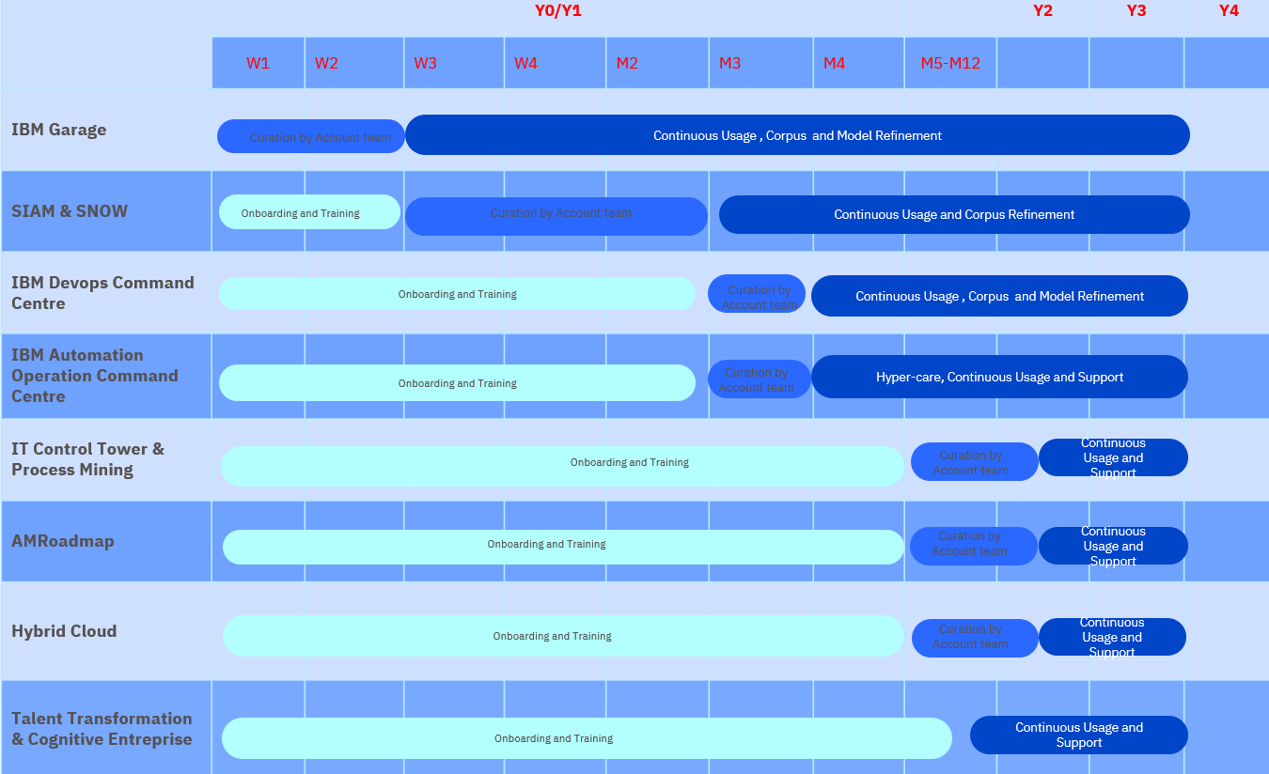
Capabilities to implement | Skills to pickup | Support from leaders
Service Integration & Management (SIAM) and SNOW | SIAM SME & SNOW | Involvement of SIAM & SNOW teams
CI-CD Automation IBM DevSecOps Command Centre | DevSecOps | Align DevSecOps team to assess & implement solution
IBM Automation Operations Command Centre | Automation, AIOps, ML | Align Automation, AIOps CoE to assess & implement solution
Test Automation | IBM Automation Platform Test Automation | Align IBM Automation Platform Test Automation SME to tap Test Automation potential
Observability, Insights, Intelligence for Innovation | CoE SME for – IT Control Tower Instana, Turbonomics, AIOps, Celenois | On pilot basis, support Garage model-based approach to implement tool
IBM Hybrid Cloud | Hybrid Cloud | Support assessment & implementation for potential IBM Hybrid Cloud implementation
Skills
High Level Action / Implementation Plan
One Time Activity
Ongoing Activity
Client Activity
Dependencies & risks
Client IT Asset consolidation require other vendor coordination. So, client by setting governance approach with all vendors can facilitate co-ordination among vendors
To meet planned timelines, any unknown dependency impacting timeline should get resolved with help of sponsor and leadership support
Getting & retaining talent to achieve plan should be one of main focus area to ensure resource availability through client transformation journey.
Client requirement and scope clarity

Slide 6
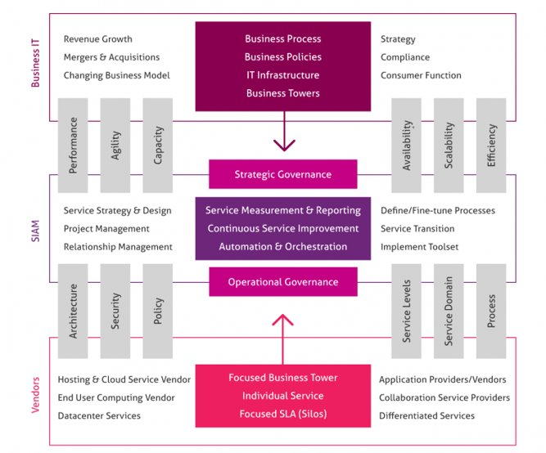
Key benefits of SIAM
A single point of contact, ownership & control for IT Services.
Clearly defined roles & responsibilities (preferably nailed down in RACI charts)
Optimized cost of services
Streamlined management of IT services
Increased customer satisfaction
Consistently applied processes
A more transparent IT landscape
1
2
3
4
5
6
7

Slide 7




Digital workers in steady state
Freeing up developer time to develop great new features to be released continuously
Reduction in Unplanned Downtime through IT Tower & AI/ML Intelligence, Hybrid Cloud
Uptime commitment
99.90%
Improved Service Agility, Quality & Innovation through SIAM & SNOW
3X-5X
Modernization for sustained innovation, growth thru’ AMR & GPA/GDPR compliant solution
Talent Transformation & Cognitive Enterprise
Cost Reduction through Automation, AIOps, RPA, BoTs
20%
Expected benefits to client
in terms of Cost optimization and improved NPS
When your technology runs better, your business performs better

Slide 8



Business results achieved by IBM
Productivity gain
DevSecOps, Automation, RPA, BoTs, AI, ML etc
Revenue
High NPS to give steady revenue & improvement opportunities to give new sources of income
Product placements
IBM solutions cross-selling to increase IBM involvement towards revenue generation
Architectural control points
SNOW, Automation Platform, Hybrid Cloud solutions shall give IBM single point of control, ownership

Slide 9
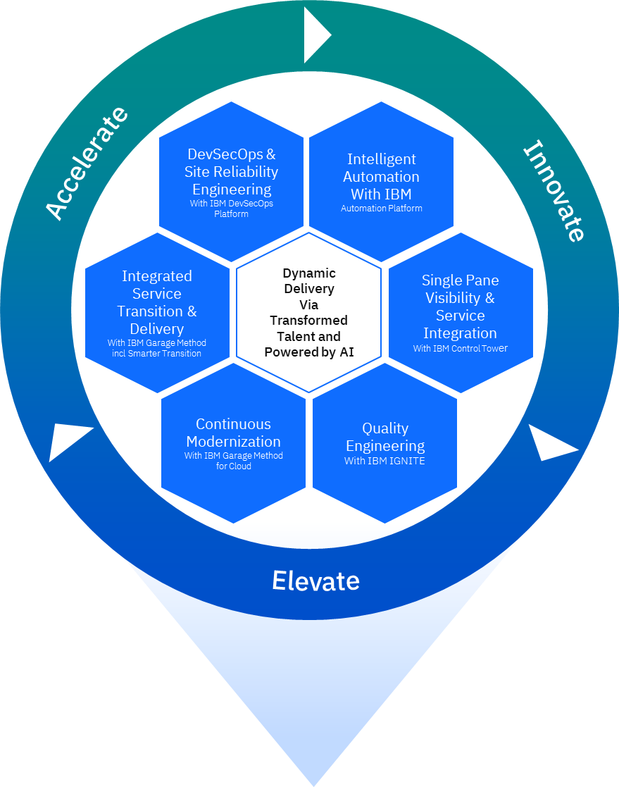
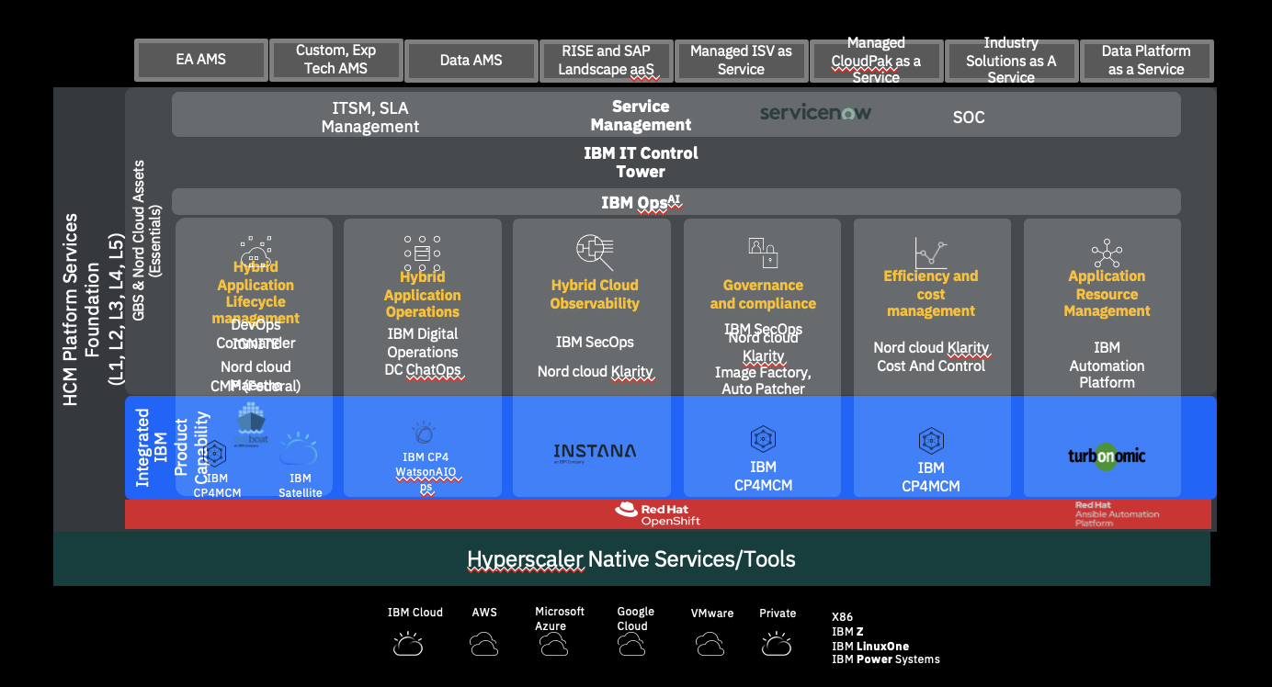
Hybrid Cloud Services Learning & Knowledge
IBM Hybrid Cloud AMS Capability Framework
Pulling it all together: IBM’s proven Hybrid Cloud AMS capability framework, backed by an integrated suite of tools and methods
Embedded at the heart of IBM Hybrid Cloud Manage Suite
Hybrid Cloud Application Managed Services
DevSecOps & Service Management
Hybrid Cloud Ops & Platform Management
Hybrid Multi-Cloud Platform (Public/Private)

Slide 10
Accelerate
Lead with Quality, Resilience, and Performance
to deliver efficiencies at a lower cost, leveraging DevOps, intensive Automation and Security by design.
Lead with Quality, Resilience, and Performance

Slide 11

Accelerate: Client Applications and Teams made faster and more efficient through automation and IBM’s Dynamic Delivery model
The Challenge
Automobile manufacturer client has a very large IT estate :
Over the years significant number of automation scripts were developed, many of which were one off use-cases. There is no visibility into what automation capabilities are available across the board.
Build and deploy of the applications follow Agile method with many DevOps tools in place. However, some steps in the processes are still manual along with completely manual testing.
Client has significant challenges related to the service quality and innovation in those areas owned by other vendors
What IBM Can Do
Though client was having automation capabilities however for consolidated view, IBM can propose IBM Automation Operations Command Centre & IBM Automation Platform on Consulting Essentials & Data Modernization to give single view on client automation capabilities & through RPA, BoTs meeting clients growing data needs.
Client with existing DevOps tools though enabled with CI-CD approach however because of lack of consolidation client earlier couldnot have consistent DevOps maturity awareness. With IBM DevSecOps shared service model & IBM DevSecOps Command Centre client could get observability on DevOps capability and DevOps tools consolidation and look for cost optimization
To overcome drawbacks associated with manual testing, client can engage tools like IBM® Test Automation solutions from Automation platform can be used for automated test creation, execution and analysis
As a result, client could get visibility on IT landscape, improvement opportunities, cost saving and faster time to market capability.
How IBM Do It
Identify opportunities for automation and DevOps Accelerators to make many existing processes faster
NextGen assessment across people, process and technology dimensions to identify right Innovation levers
New Ways of Working in a Dynamic Delivery Model
Impact. Client IT asset consolidation, cost saving, faster time to market
Through client consultation, current IT landscape assessment roadmap definition, prioritization to add value
IT asset consolidation for automation capabilities
DevSecOps tool consolidation towards cost optimization & faster time to market
Notes:
This use case encapsulates the elements of “Accelerate”. The application portfolio assessment is driven by a persistent business problem that led to identifying a specific technical debt and the value stream that was getting impacted. Once this got validated by business and the fix was quickly deployed apart from ensuring that the rest of applications ran smoothly, the savings can be significant.

Slide 12
Accelerate
IBM Automation Operations Command Centre to give single view on client automation capabilities. IBM Services Essentials for Automation, RPA, BoTs can be used to detect and resolve issues faster with automation.
With IBM DevSecOps shared service model & IBM DevSecOps Command Centre client could get observability on DevOps capability and DevOps tools consolidation. This in turn helps achieving faster time to market and quality.
Use of Watson AIOps backed up by the SRE principles poised to use a backbone of AI insights to speed up issue resolution, optimize cost, minimize risk and maximize value for company and users
IBM Dynamic Delivery leverages the IBM Garage for agility and innovation at scale and integrates advanced technologies to help emerge stronger than ever
IT
Automation
DevOps Deploy & Manage
AIOps & SREs
Dynamic
Delivery

Slide 13
Innovate
Leverage Insights for Innovation
to gain observability into the application and data estate. AI/ML-led insights will inject process automation into siloed and inefficient workflows for increased throughput and business performance.
Leverage Insights for Innovation

Slide 14

Innovate: Your processes and workflows augmented and streamlined through insights and intelligent process mapping
The Challenge
Automobile manufacturer below challenges can be solved in Innovate stage :
The client has a very large IT estate supported by multiple Vendors, and IBM is managing a small portion of the portfolio which includes few mission critical applications including the external facing Web application for their connected-cars solution.
Many other critical applications in the portfolio are managed by two other vendors, and based on our experience, client has significant challenges related to the service quality and innovation in those areas.
What IBM Did
IBM Garage can work with LoBs to understand the operational inefficiencies and co-design the new solution. To resolve service quality concerns, proposing SIAM & SNOW rollout to get all vendor organizations on common platform for observability, manageability and service quality improvement.
IT Control Tower shall give IT Observability to see that all mission critical applications are running fine. Observe application in order to check health and whether anything’s amiss, know what caused it to fix it expeditiously. Instana for ( IT Observability ), Turbonomic for ( Application Resourcing ), Watson AIOps for ( Automated IT Ops ) can be leveraged for actionable insights. Helps to drive costs down and ensure seamless availability of IT Operations
Celonis Process Mining with Celonis can help to identify weaknesses, bottlenecks & problems with both Business & IT processes across application landscape. Lead time will sped up & processes more efficient by increasing automation & avoiding manual rework.
How IBM Did It
Increasing visibility across full stack and workflows, accessed through the Control Tower and Celonis
IBM insights & observability usher Innovation driven by business value by improving operational throughput across your Enterprise
Real time application health-check in relation with business KPIs
Actionable insights for IT & business teams
Process mining for streamlined workflows
IBM Garage co-working model
Impact. Observability to identify optimization opportunities, remove bottlenecks, process improvement
Service quality improvement
IT Control Tower help observability, application resourcing
AIOps for actionable insights & innovation objective
Case study is Illustrative, and indicative of IBM activities and impact

Slide 15
Innovate
Give IT Observability to see that all mission critical applications are running fine & take action.
Celonis helps identify weaknesses, bottlenecks and problems with both Business and IT processes across application landscape.
Co-work with LoBs to understand the operational inefficiencies, service quality issues and co-design the new solution by proposing SIAM & SNOW based consolidation
IT Control Tower
Process Mining
Garage Co-Working

Slide 16
Elevate
Enable Growth and Experience
to lay the foundation for transformation to a modern IT ecosystem with talent transformation of a hybrid workforce, and continued infusion of exponential technologies and ways of working.
Target Growth and Experience

Slide 17

Elevate: Client team’s experience enhanced through talent transformation and a modernization roadmap driving client towards the Cognitive Enterprise
The Challenge
Automobile manufacturer below challenges can be solved in Elevate stage:
While most applications are hosted in private cloud, some critical applications are running on AWS.
Client also communicated that the connected-cars applications supported by IBM are expected to handle increased load in the coming quarters and asked IBM to provide an uptime commitment of at least 99.90%.
Many of these applications are running on legacy and outdated platforms with many compliance issues
What IBM Did
As part of Application Modernization Roadmap (AMR) findings and Garage Co-Create, Co-Execute, Co-operate model, these applications can move to cloud and can be re-architected. IBM can provision Hybrid cloud solution which shall fit existing AWS etc client cloud setup and also can meet future load increase requirements. By outsourcing services to IBM Hybrid cloud provider, client can look for meeting 99.90% uptime service commitment from IBM.
Re-Architectecting legacy applications and Monolithic to microservices approach, existing applications can be containerized and provisioned on cloud
With applications availability on cloud, using cloud capabilitiy and data, client can aim to make use of exponential technologies like Cognitive automation, IoT, 5G for adding value to client offerings
IBM can help the client to leverage predefined T-shaped skill models to modernize the teams that are working together to solve challenges through Accelerate, Innovate, and Elevate journey. IBM can help client teams build the appropriate skillsets – achieving depth and breadth of skills in client practitioners.
How IBM Did It
Initiating, sustaining, and governing talent and enterprise-wide cultural change initiatives at scale
Staying relevant and flexible through continuous modernization
pact. Processing Time Reduced by:
Impact.
NextGen capability enabled with Talent transformation to meet NextGen AMR goal to achieve faster time to market & remain competitive towards becoming cognitive enterprise.
Competitiveness
Faster time to market
With IBM Hybrid platform, Automation solutions potential to tap AI/ML capabilities to get actionable insights towards becoming smart/cognitive enterprise.

Slide 18
Elevate
Using knowledge gained of client application estate through co-working and observability, and powered by IBM partner ecosystem capabilities, IBM can help design a roadmap for continuous modernization aligned to larger cloud and business transformation objectives for impactful business outcomes.
IBM will help client teams build the appropriate skillsets – achieving depth and breadth of skills in client practitioners.
By leveraging proprietary assets, tools, and methodologies like IBM Garage, IBM provide client with an approach to successfully initiate, sustain, and govern talent and cultural change initiatives at scale, so that client teams learn how to coexist in the new Hybrid World alongside partnerships and ecosystems.
Modernization Roadmap
Talent Transformation
Cognitive Enterprise

Slide 19
Notes:
Sources:
451: https://clients.451research.com/reportaction/98047/Toc
Notes:
Cloud is the primary driver going forward, with 57% of workloads primarily running on hosted or public cloud environments.
Meanwhile, private and dedicated environments, will reduce in usage but remain for more back office, ERP, SCM.
Note: Cloud ERP is in demand, but compliance issues and difficulties in moving sensitive data remain an issue and rule out “life and shift” – Cloud Alliance, 2019.

Slide 20
Business Opportunity or Client challenge
What business problem is the client trying to solve? – Multivendor, Legacy applications, Growing business requirements,
Is this an innovative solution or a response to an industry trend? – Solution follows IBM NextGen offering and Garage model to Co-create, Co-execute, Co-operate
Is this a pure technology upgrade/ replacement engagement? – Using client’s existing asset and vendor base, solution attempts to use NextGen offerings to not just meet client SLA but to give value to the client with the help of 3 tracks ACCELERATE, INNOVATE & ELEVATE
What is the compelling reason for the client to act? – Client has large IT asset, multi-vendor team which client seem not able to manage with existing capabilities. Client expect growth in business, seeing quality issues in vendor deliverables, has legacy applications which could cause impact on Client competitive-ness and time to market requirements.
Describe the scope and complexity of the problem. Does it span several locations and geographies? Are multiple business units involved? What is the complexity of the hardware and software environments with which you are working? – Multivendor, legacy applications, distributed automation, manual testing are the existing complexities in client IT landscape
Describe your relationship and communications with your client management. – In PM capacity, interact with client on ongoing delivery scope items while looking for providing value to client towards achieving account growth expectations
Solution:
Describe the solution proposed for the client. – Solution based on HCM 3 tracks i.e ACCELERATE, INNOVATE, ELEVATE. Proposing IBM offerings to enable client to get rid of pain areas.
What are the key components and capabilities of the solution? – Using NextGen offerings enabling client to achieve cost optimization, faster time to market, maintain competitive-ness
Describe your specific role on the team in progressing the solution. – In delivery project manager capacity, continuously meet client SLA and give client value towards getting more business
What key technical decisions will you have to make? What alternatives can be considered? What is the reason for your final decision? – Keeping existing client setup wherever possible however uplifting certain areas for which client expressed concern. Promoting IBM solutions to enable ease of integration and manageability at optimized cost.
What major problems or obstacles do you anticipate and how will you overcome them? – Talent which can help with NextGen transformation could be major focus area along with leader and management support for successful result.
Result:
Will the solution meet the client’s requirements? – SIAM, IBM Hybrid cloud, DevSecOps, Automation Control Centre these solutions shall help client achieve cost optimization and faster time-to-market objective
What will be the business results achieved by the client? – Cost optimization, faster time to market, competitiveness, quality, observability etc
What will be the business results achieved by IBM? (Productivity gain, Revenue, product placements, architectural control points, and so on) – IBM shall incur lesser cost, by proposing in-house products gowth in business, with SIAM etc offering can control service provisioning effectively
Will this plan of action (POA) lead to additional business for IBM? – Yes
Can this POA be reused by others to springboard additional customer deployments? – Depending on each client requirement and as per customer buy-in, solution can be customized to get results.

Slide 21
PM—HCM
High Level Action / Implementation Plan
One Time Activity
Ongoing Activity
Client Activity
Dependencies & risks –
Client IT Asset consolidation require other vendor coordination. So, client can by setting governance approach with all vendors can facilitate co-ordination among vendor
To meet planned timelines, any unknown dependency impacting timeline should get resolved with help of sponsor and leadership support
Getting & retaining talent to achieve plan should be one of main focus area to ensure resource availability
 | Y0/Y1 |  |  |  |  |  |  |  | Y2 | Y3 | Y4
 | W1 | W2 | W3 | W4 | M2 | M3 | M4 | M5-M12
IBM Garage
SIAM & SNOW
IBM Devops Command Centre
IBM Automation Operation Command Centre
IT Control Tower & Process Mining
AMRoadmap
Hybrid Cloud
Talent Transformation & Cognitive Entreprise
Curation by Account team
Continuous Usage , Corpus and Model Refinement
Onboarding and Training
Curation by Account team
Continuous Usage and Corpus Refinement
Onboarding and Training
Curation by Account team
Continuous Usage , Corpus and Model Refinement
Onboarding and Training
Curation by Account team
Hyper-care, Continuous Usage and Support
Capabilities to implement | Skills to pickup | Support from leaders
SIAM and SNOW | SIAM SME & SNOW team | Involvement of SIAM & SNOW teams
IBM DevSecOps Command Centre | DevSecOps | Align DevSecOps team to assess & implement solution
IBM Automation Operations Command Centre | Automation, AIOps, ML CoE | Align Automation, AIOps CoE to assess & implement solution
IBM Rational Test | IBM Rational Test | Align IBM Rational Test CoE to tap Test Automation potential
IT Control Tower Instana, Turbonomics, AIOps Celenois | CoE SME for – IT Control Tower Instana, Turbonomics, AIOps, Celenois | On pilot basis, support Garage model based approach to implement tool
IBM Hybrid Cloud | Hybrid Cloud | Support assessment for potential IBM Hybrid Cloud implementation
Onboarding and Training
Curation by Account team
Continuous Usage and Support
Onboarding and Training
Curation by Account team
Continuous Usage and Support
Onboarding and Training
Curation by Account team
Continuous Usage and Support
Onboarding and Training
Continuous Usage and Support

Slide 22

Drive comprehensive alignment with new ways of working co-created in the IBM Garage
Hybrid Cloud Services Learning & Knowledge
Gary from the IBM Garage, leading a prioritization workshop
We bring together your experts, like Bob and Ted (right), to help drive a pipeline that works for your IT, business, and customers.
 | Workshop kickoff | Ideation | Prioritization | Pipeline Creation
IBM Garage | Brings proven IBM Garage method | Garage brings Ted and Bob together to deconstruct the problem in terms of IT and business gaps and identify focus value streams | Gary works with Bob to start driving strategy discussions for change and the MVPs for the business-critical value streams | Gary leads Ted and Bob in defining the BizDevSecOps charter, operating model, pipeline for the product backlog
Your IT Team | Brings knowledge of IT systems, project pipeline | Ted understands the components involved, and their correlation across the stack for a service element of a customer transaction | Ted, for each value stream, would be able to provide the spots of application and process inefficiencies and automation debt | Ted would work with Gary and the Garage for any additional functional gaps, apart from defining the user stories to remediate the IT inefficiencies and debt
Your Business Users | Brings knowledge of business process and outcomes | Bob will provide a view of the business problem with specific business service and the business KPIs getting impacted | Bob helps drive prioritization based on the KPI gap with benchmark and value streams based on financial impact | Within the value streams, Bob will identify the sequence that would be driven by business outcome and user/customer experience
Ted from IT
Bob from Business
Notes:
This exemplifies and amplifies the collaboration between IT and business, embracing the BizDevSecOps way of engineering a change, using IBM’s Garage workshop. The table shows the workshop phases, what each persona from business and IT and Garage bring to the table and what outcomes are realized for each phase and how each one complements the other.

Slide 23
IBM Consulting SI Methodology & Deliverables
Phases
CONTINUAL MATURITY ASSESSMENT
DUE DILIGENCE / ASESSMENT
STRATEGY AND ROADMAP FORMULATION
DESIGN
IMPLEMENT
HANDOVER / RUN
Understand and perform due diligence of the existing environment and supplier landscape
Create a plan with the best suited SI Model and the journey ahead
Develop detailed processes, interfaces, governance models, reports and integrated tools
Implement the designed processes, mechanisms and tools
Stabilize the project, sustain it until handover
to the operations partner or
Run the SI Operations
Conduct a year-on-year maturity assessment and embrace continual improvement methodology
Overview
SI Due-diligence plan
Stakeholder's list
Interview schedules
Current state understanding and findings
Design plan (MVP)
Detail out a comprehensive SI strategy (Internal, External, Hybrid)
Create a detailed implementation roadmap
Target Ops model and Org Structure
Integrated process framework
Integrated Governance and Collaboration framework
Integrated Tools framework
SLAs and OLAs
Final implementation plan
Training materials
Trainings to the teams
Supplier onboarding
Process pilot ad per the plan
Cross-supplier forums pilot
Tool Implementation
SI Transition plan
Completion of all transition activities
Implementation of identified gap and action items
Transition sign-off
Assessment Report with Gaps and Recommendations
Year on Year improvement plan
Outcomes

